Slide 1
Layout Controls
Canvas: This control enables you to position child controls any way you see fit. It doesn’t place any restrictions on child control positioning, but nor does it provide any assistance in positioning.
DockPanel: This control enables you to dock child controls against one of its four edges. The last child control fills the remaining space.
Grid: This control enables flexible positioning of child controls. You can divide the layout of this control into rows and columns, which enables you to align controls in a grid layout.

Slide 2
Layout Controls
StackPanel: This control positions its child controls in a sequential horizontal or vertical layout.
WrapPanel: This control positions its child controls in a sequential horizontal or vertical layout as StackPanel, but rather than a single row or column of controls, this control wraps its children into multiple rows or columns according to the space available.

Slide 3
Grid
This control enables flexible positioning of child controls.
You can divide the layout of this control into rows and columns, which enables you to align controls in a grid layout.
You can define rows and columns in the grid by clicking the edges of the grid in the Design View.
If you move the mouse pointer to the edge of the grid, a yellow line is drawn across the Design View; if you click the edge, the necessary XAML is inserted.

Slide 4
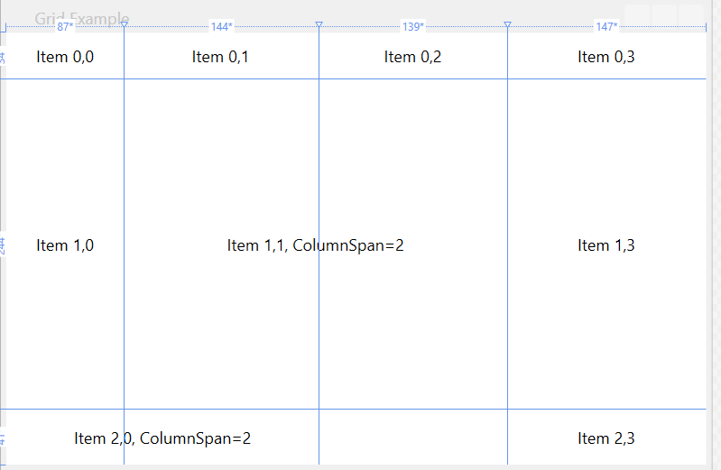
Grid Grid Example
Design the following Window:

Slide 5
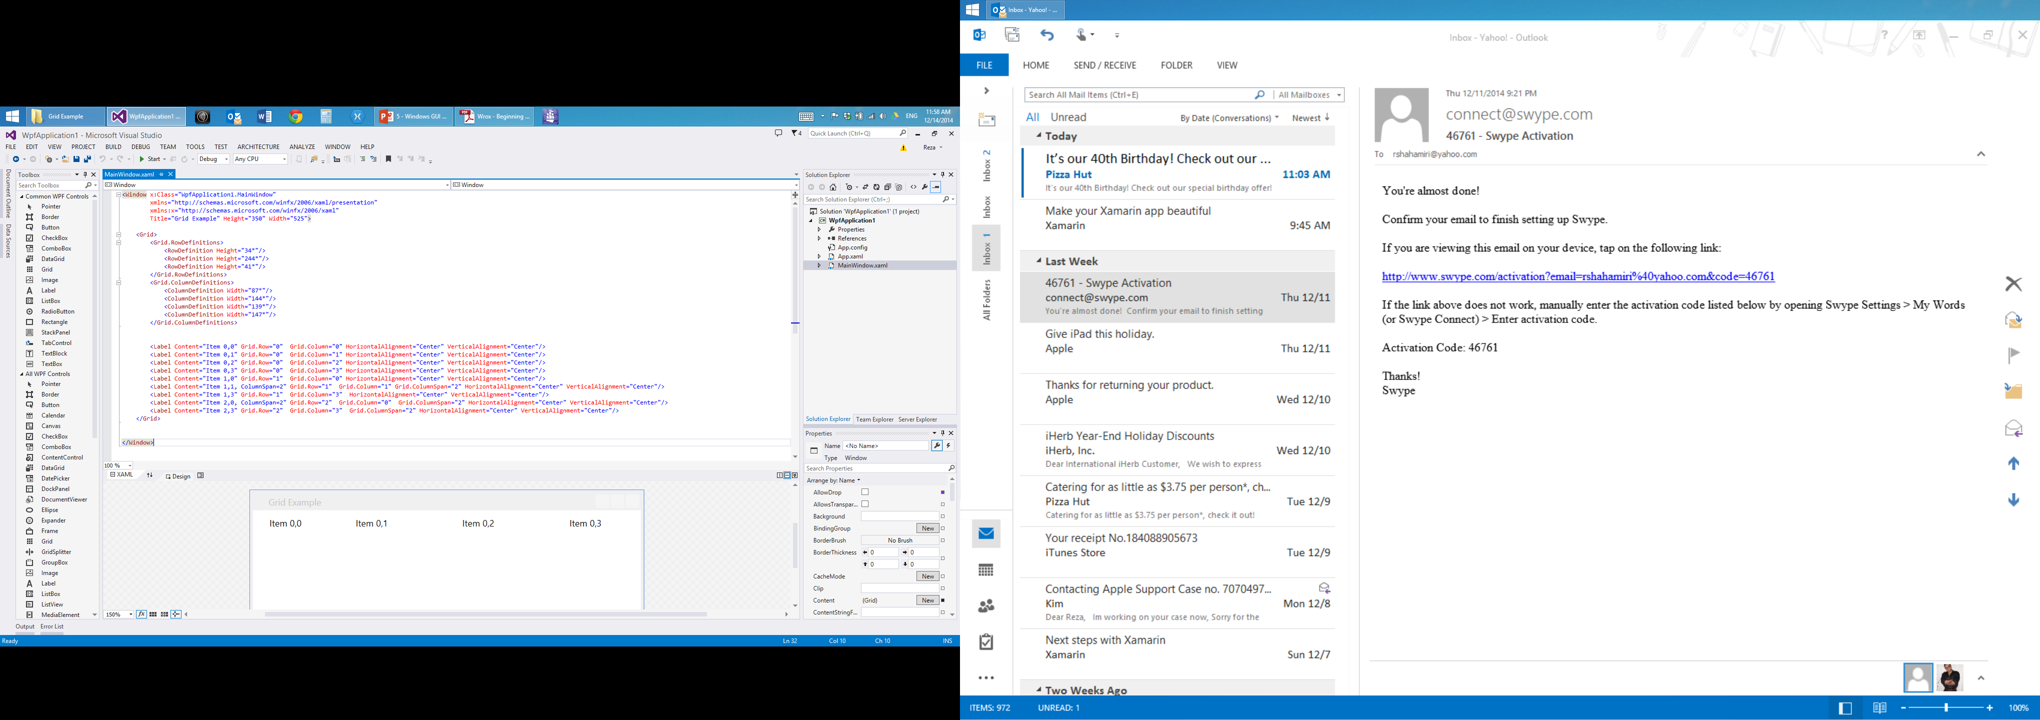
Grid Grid Example
By setting Height or Width property of Grid Row or Column to a number following by *, you can tell the compiler witch section of your Window to resize when you resize the Window.

Slide 6
Canvas Layout Example
Canvas Layout detail:
Lays out element by absolute positioning.
Elements in canvas are absolute positioned using Top and Left property.
Canvas layout is useful in situation where UI elements never move.
Canvas Property used for Absolute Positioning are
Canvas.Top - Gets or sets a value that represents the distance between the top of an element and the top of its parent Canvas.
Canvas.Left - Gets or sets a value that represents the distance between the left side of an element and the left side of its parent Canvas.
Canvas.Right - Gets or sets a value that represents the distance between the right side of an element and the right side of its parent Canvas.
Canvas.Bottom - Gets or sets a value that represents the distance between the top of an element and the top of its parent Canvas.

Slide 7
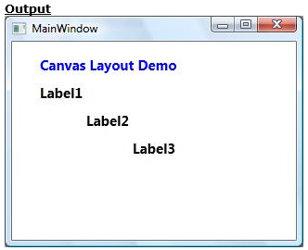
Canvas Layout Example
<Canvas>
<Label Content="Canvas Layout Demo"
FontSize="15" FontWeight="Bold"
Foreground="Blue"
Canvas.Top="10" Canvas.Left="25"/>
<Label Content="Label1" FontSize="15" FontWeight="Bold"
Canvas.Top="40" Canvas.Left="25"/>
<Label Content="Label2" FontSize="15" FontWeight="Bold"
Canvas.Top="70" Canvas.Left="75"/>
<Label Content="Label3" FontSize="15" FontWeight="Bold"
Canvas.Top="100" Canvas.Left="125"/>
</Canvas>

Slide 8
Stack panel
Lays out element by stacking them one after the other.
Items can either be stacked vertically or horizontally. By default items are stacked vertical.
Thus stack panel control is used in positioning control in either a row or column format.
They are mostly used to arrange a small subsection of UI.

Slide 9
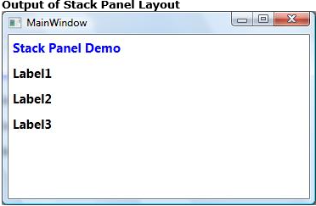
Stack Panel Example
StackPanel>
<Label Content="Stack Panel Demo"
FontSize="15" FontWeight="Bold"
Foreground="Blue"/>
<Label Content="Label1" FontSize="15" FontWeight="Bold" />
<Label Content="Label2" FontSize="15" FontWeight="Bold" />
<Label Content="Label3" FontSize="15" FontWeight="Bold" />
</StackPanel>

Slide 10
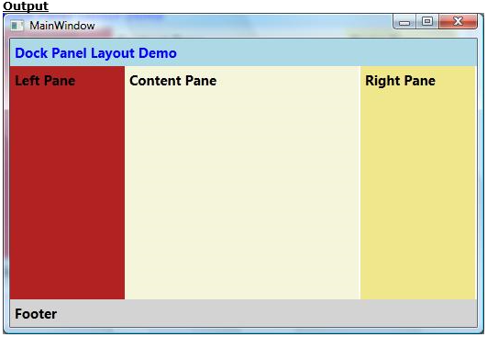
Dock panel in detail: Dock Panel Layout allows elements to be docked to the edges of the panel’s container, similar to windows forms docking
<DockPanel>
<Label Content="Dock Panel Layout Demo"
FontSize="15" FontWeight="Bold" Background="LightBlue"
Foreground="Blue" DockPanel.Dock="Top"/>
<Label Content="Footer" FontSize="15" FontWeight="Bold"
Background="LightGray"
DockPanel.Dock="Bottom" />
<Label Content="Left Pane" FontSize="15" FontWeight="Bold"
Width="125" Background="Firebrick"
DockPanel.Dock="Left"/>
<Label Content="Content Pane" FontSize="15" FontWeight="Bold"
Width="255"
Background="Beige"/>
<Label Content="Right Pane" FontSize="15" FontWeight="Bold"
Width="125" Background="Khaki"
DockPanel.Dock="Right"/>
</DockPanel>

Slide 11
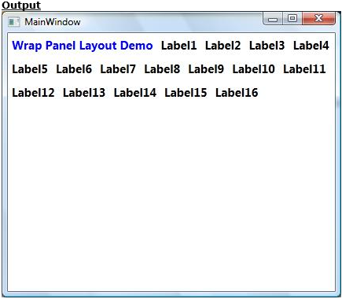
Wrap layout Example: Wrap Panel lays out items from left to right
<WrapPanel>
<Label Content="Wrap Panel Layout Demo"
FontSize="15" FontWeight="Bold"
Foreground="Blue"/>
<Label Content="Label1" FontSize="15" FontWeight="Bold" />
<Label Content="Label2" FontSize="15" FontWeight="Bold" />
<Label Content="Label3" FontSize="15" FontWeight="Bold" />
<Label Content="Label4" FontSize="15" FontWeight="Bold" />
<Label Content="Label5" FontSize="15" FontWeight="Bold" />
<Label Content="Label6" FontSize="15" FontWeight="Bold" />
<Label Content="Label7" FontSize="15" FontWeight="Bold" />
<Label Content="Label8" FontSize="15" FontWeight="Bold" />
<Label Content="Label9" FontSize="15" FontWeight="Bold" />
<Label Content="Label10" FontSize="15" FontWeight="Bold" />
<Label Content="Label11" FontSize="15" FontWeight="Bold" />
<Label Content="Label12" FontSize="15" FontWeight="Bold" />
</WrapPanel>

Slide 12
Nesting of Layout
Nesting of Layout is widely used to combine advantage of more than one layout.
Considering example of real world wherein we used grid layout for outlining and used stackpanel to display controls inside it

Slide 13
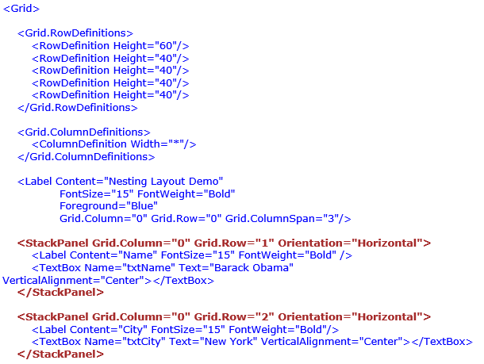
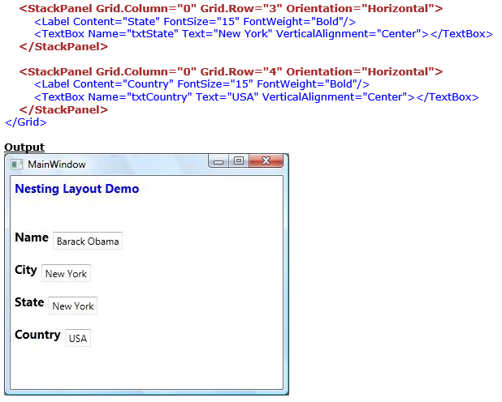
Nesting layout Example:

